Slide 1
Math 769: Statistical Learning

Slide 2
Ridge Regression
Shahrzad Jamshidi, PhD

Slide 3
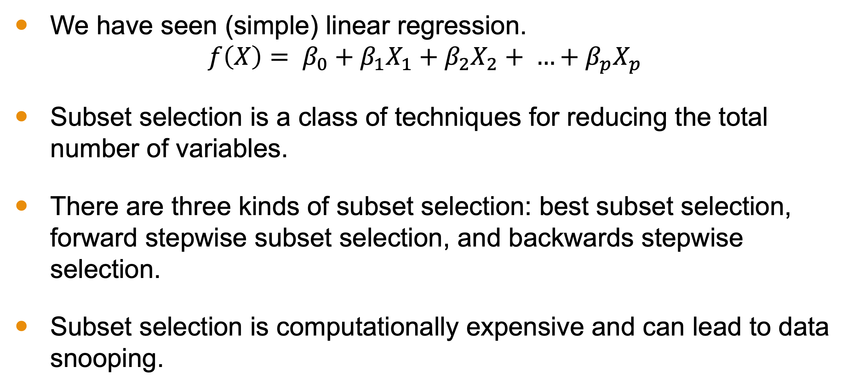
Last Lesson
We have seen (simple) linear regression.
$$f\left(X\right)= β_{0}+β_{1}X_{1}+β_{2}X_{2}+ …+β_{p}X_{p}$$
Subset selection is a class of techniques for reducing the total number of variables.
There are three kinds of subset selection: best subset selection, forward stepwise subset selection, and backwards stepwise selection.
Subset selection is computationally expensive and can lead to data snooping.

Slide 4
Objectives
Describe regularization and define hyperparameter.
Give the formula for ridge regression and explain how it works.
Describe the benefits and drawbacks of ridge regression.

Slide 5
Issues with Linear Regression
Overfitting: Model becomes too complex with too many variables; fits the noise.
Multicollinearity: Although we assume no collinearity, this can exist among independent variables.
Large Coefficients: Might lead to unstable models.

Slide 6
Regularization
Idea: Add a penalty to the linear regression coefficients!
Helps in reducing model complexity.
Ridge regression is one such regularization technique.

Slide 7
Ridge Regression - Intuition
Instead of just minimizing the sum of squared residuals, also minimize the magnitude of coefficients.
We trade off between fitting our data well and keeping coefficients small.

Slide 8
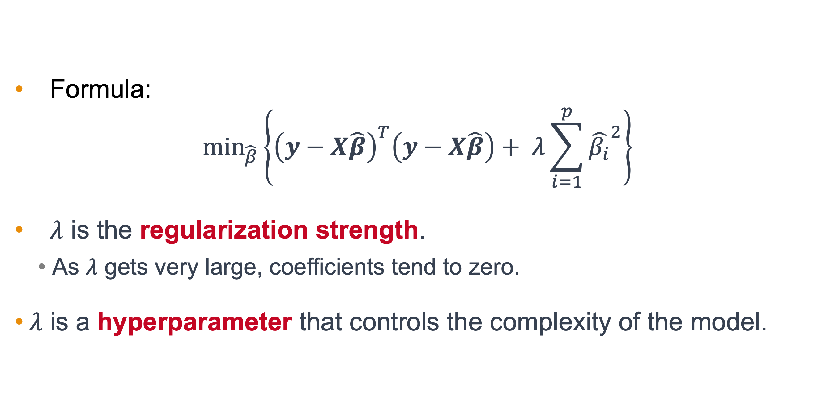

Ridge Regression Formula and Role of $λ$
Formula:
$$\min_{\hat{β}}\left\{{\left(y−X\hat{β}\right)}^{T}\left(y−X\hat{β}\right)+ λ\sum_{i=1}^{p}{{\hat{β_{i}}}^{2}}\right\}$$
$λ$ is the regularization strength.
As $λ$ gets very large, coefficients tend to zero.
$λ$ is a hyperparameter that controls the complexity of the model.

Slide 9

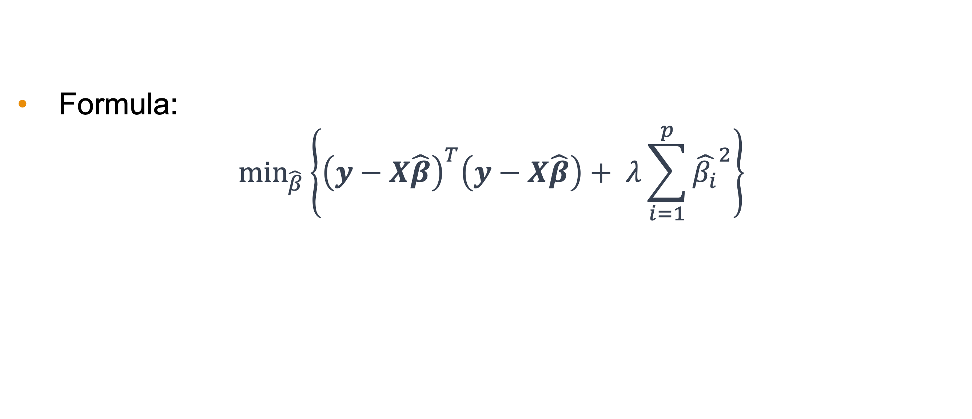
Notation
Residual Sum of Squares
Formula:
$$\min_{\hat{β}}\left\{{\left(y−X\hat{β}\right)}^{T}\left(y−X\hat{β}\right)+ λ\sum_{i=1}^{p}{{\hat{β_{i}}}^{2}}\right\}$$
$${\hat{β}}_{1}^{2}+{\hat{β}}_{2}^{2}+…+{\hat{β}}_{p}^{2}$$
Choices where $\hat{β_{i}}$ are large will be less desirable for minimization.

Slide 10
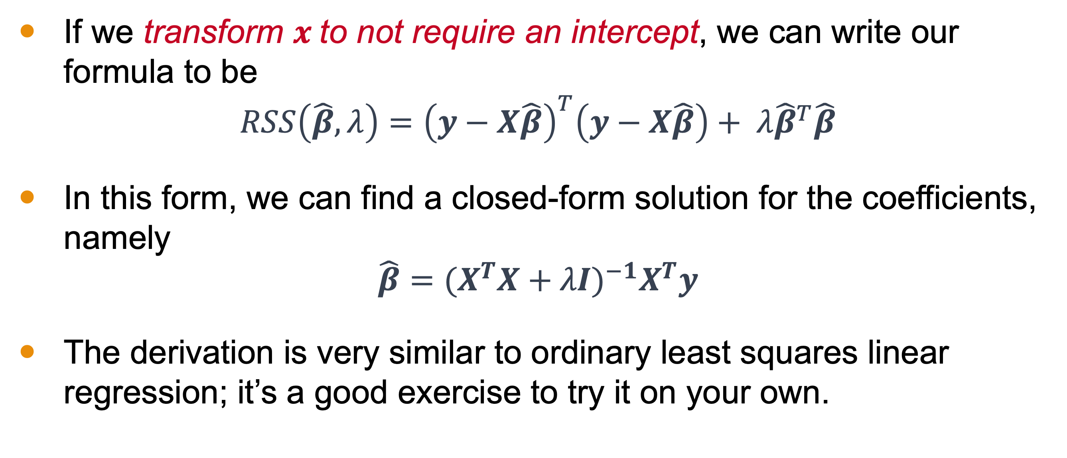
Closed Form Solution
If we transform $x$to not require an intercept, we can write our formula to be
$$RSS\left(\hat{β},λ\right)={\left(y−X\hat{β}\right)}^{T}\left(y−X\hat{β}\right)+ λ{\hat{β}}^{T}\hat{β}$$
In this form, we can find a closed-form solution for the coefficients, namely
$$\hat{β}={(X^{T}X+λI)}^{−1}X^{T}y$$
The derivation is very similar to ordinary least squares linear regression; it’s a good exercise to try it on your own.
Notes:
***Cut to board showing how x is transformed,

Slide 11
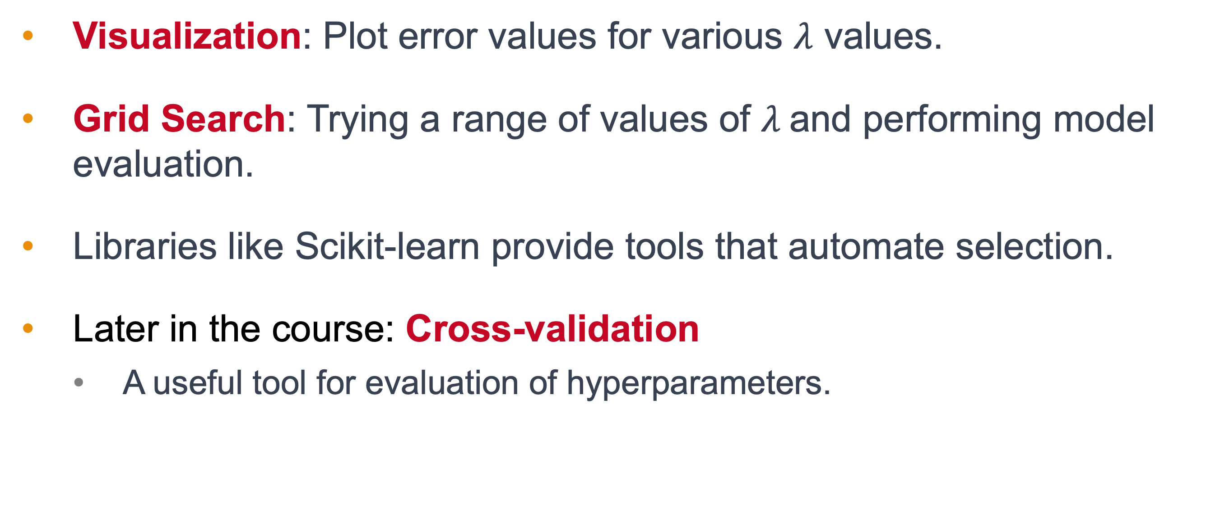

How to Choose $λ$
Visualization: Plot error values for various $λ$ values.
Grid Search: Trying a range of values of $λ$and performing model evaluation.
Libraries like Scikit-learn provide tools that automate selection.
Later in the course: Cross-validation
A useful tool for evaluation of hyperparameters.

Slide 12
Benefits of Ridge Regression
Reduces overfitting.
Handles multicollinearity.
Avoids overly large coefficients.
More stable model in presence of correlated features.

Slide 13
Limitations of Ridge Regression
Does not perform variable selection
All features are included in the model.
Might not work well if only a few predictors are influential.

Slide 14
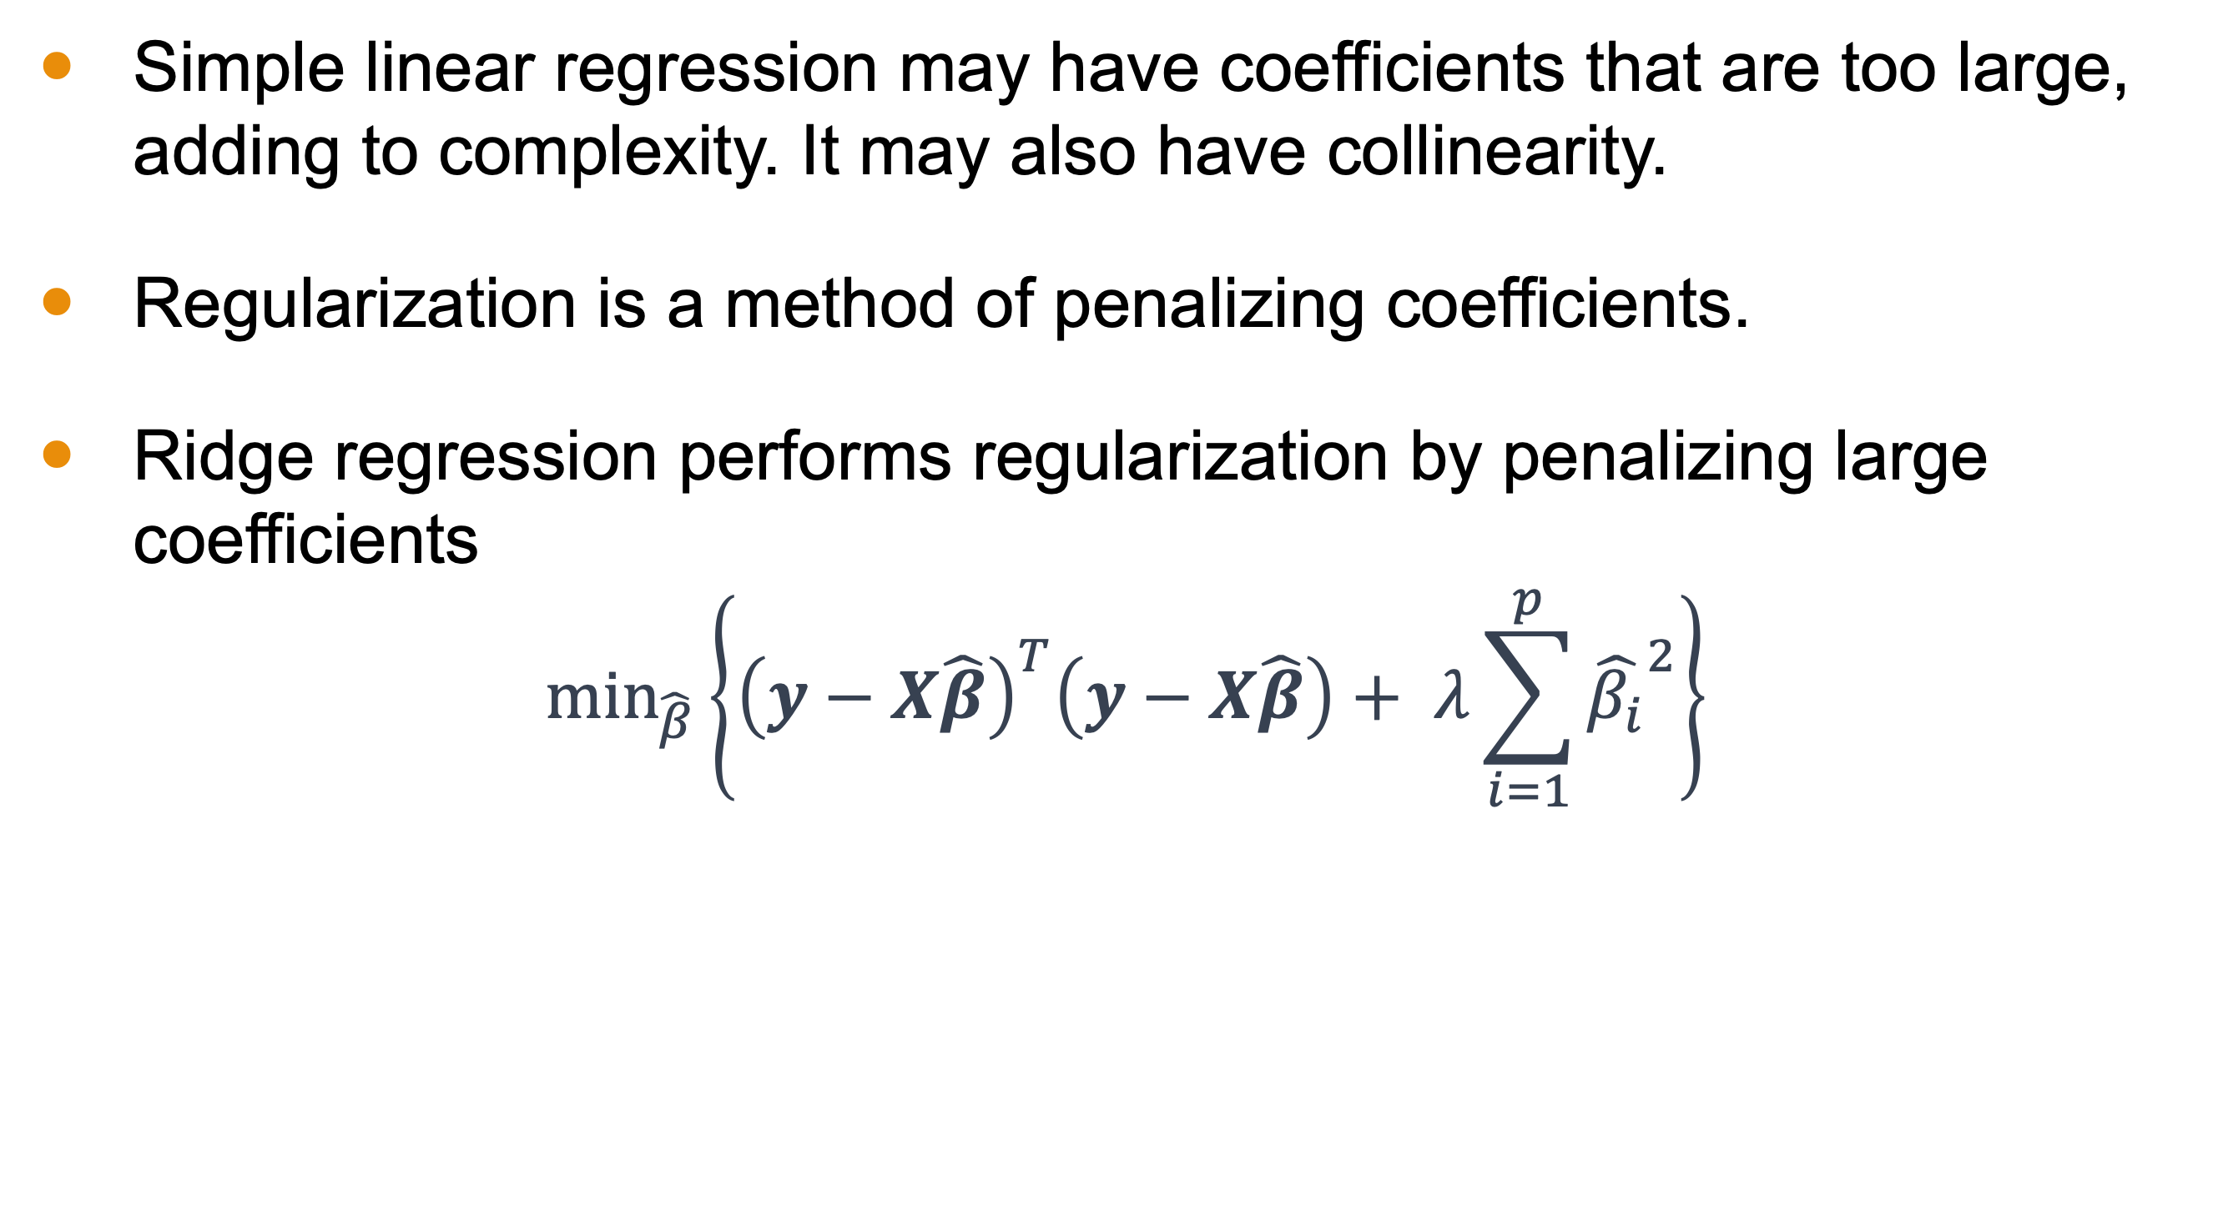
Conclusion
Simple linear regression may have coefficients that are too large, adding to complexity. It may also have collinearity.
Regularization is a method of penalizing coefficients.
Ridge regression performs regularization by penalizing large coefficients
$$\min_{\hat{β}}\left\{{\left(y−X\hat{β}\right)}^{T}\left(y−X\hat{β}\right)+ λ\sum_{i=1}^{p}{{\hat{β_{i}}}^{2}}\right\}$$

Slide 15
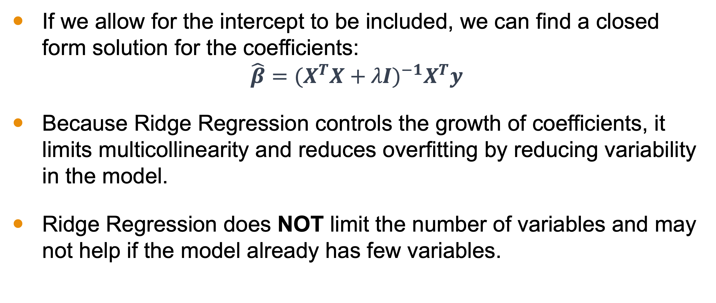
Conclusion
If we allow for the intercept to be included, we can find a closed form solution for the coefficients:
$$\hat{β}={(X^{T}X+λI)}^{−1}X^{T}y$$
Because Ridge Regression controls the growth of coefficients, it limits multicollinearity and reduces overfitting by reducing variability in the model.
Ridge Regression does NOT limit the number of variables and may not help if the model already has few variables.

